Slide 1

os Module Functions to handle Dataset flower

Slide 2
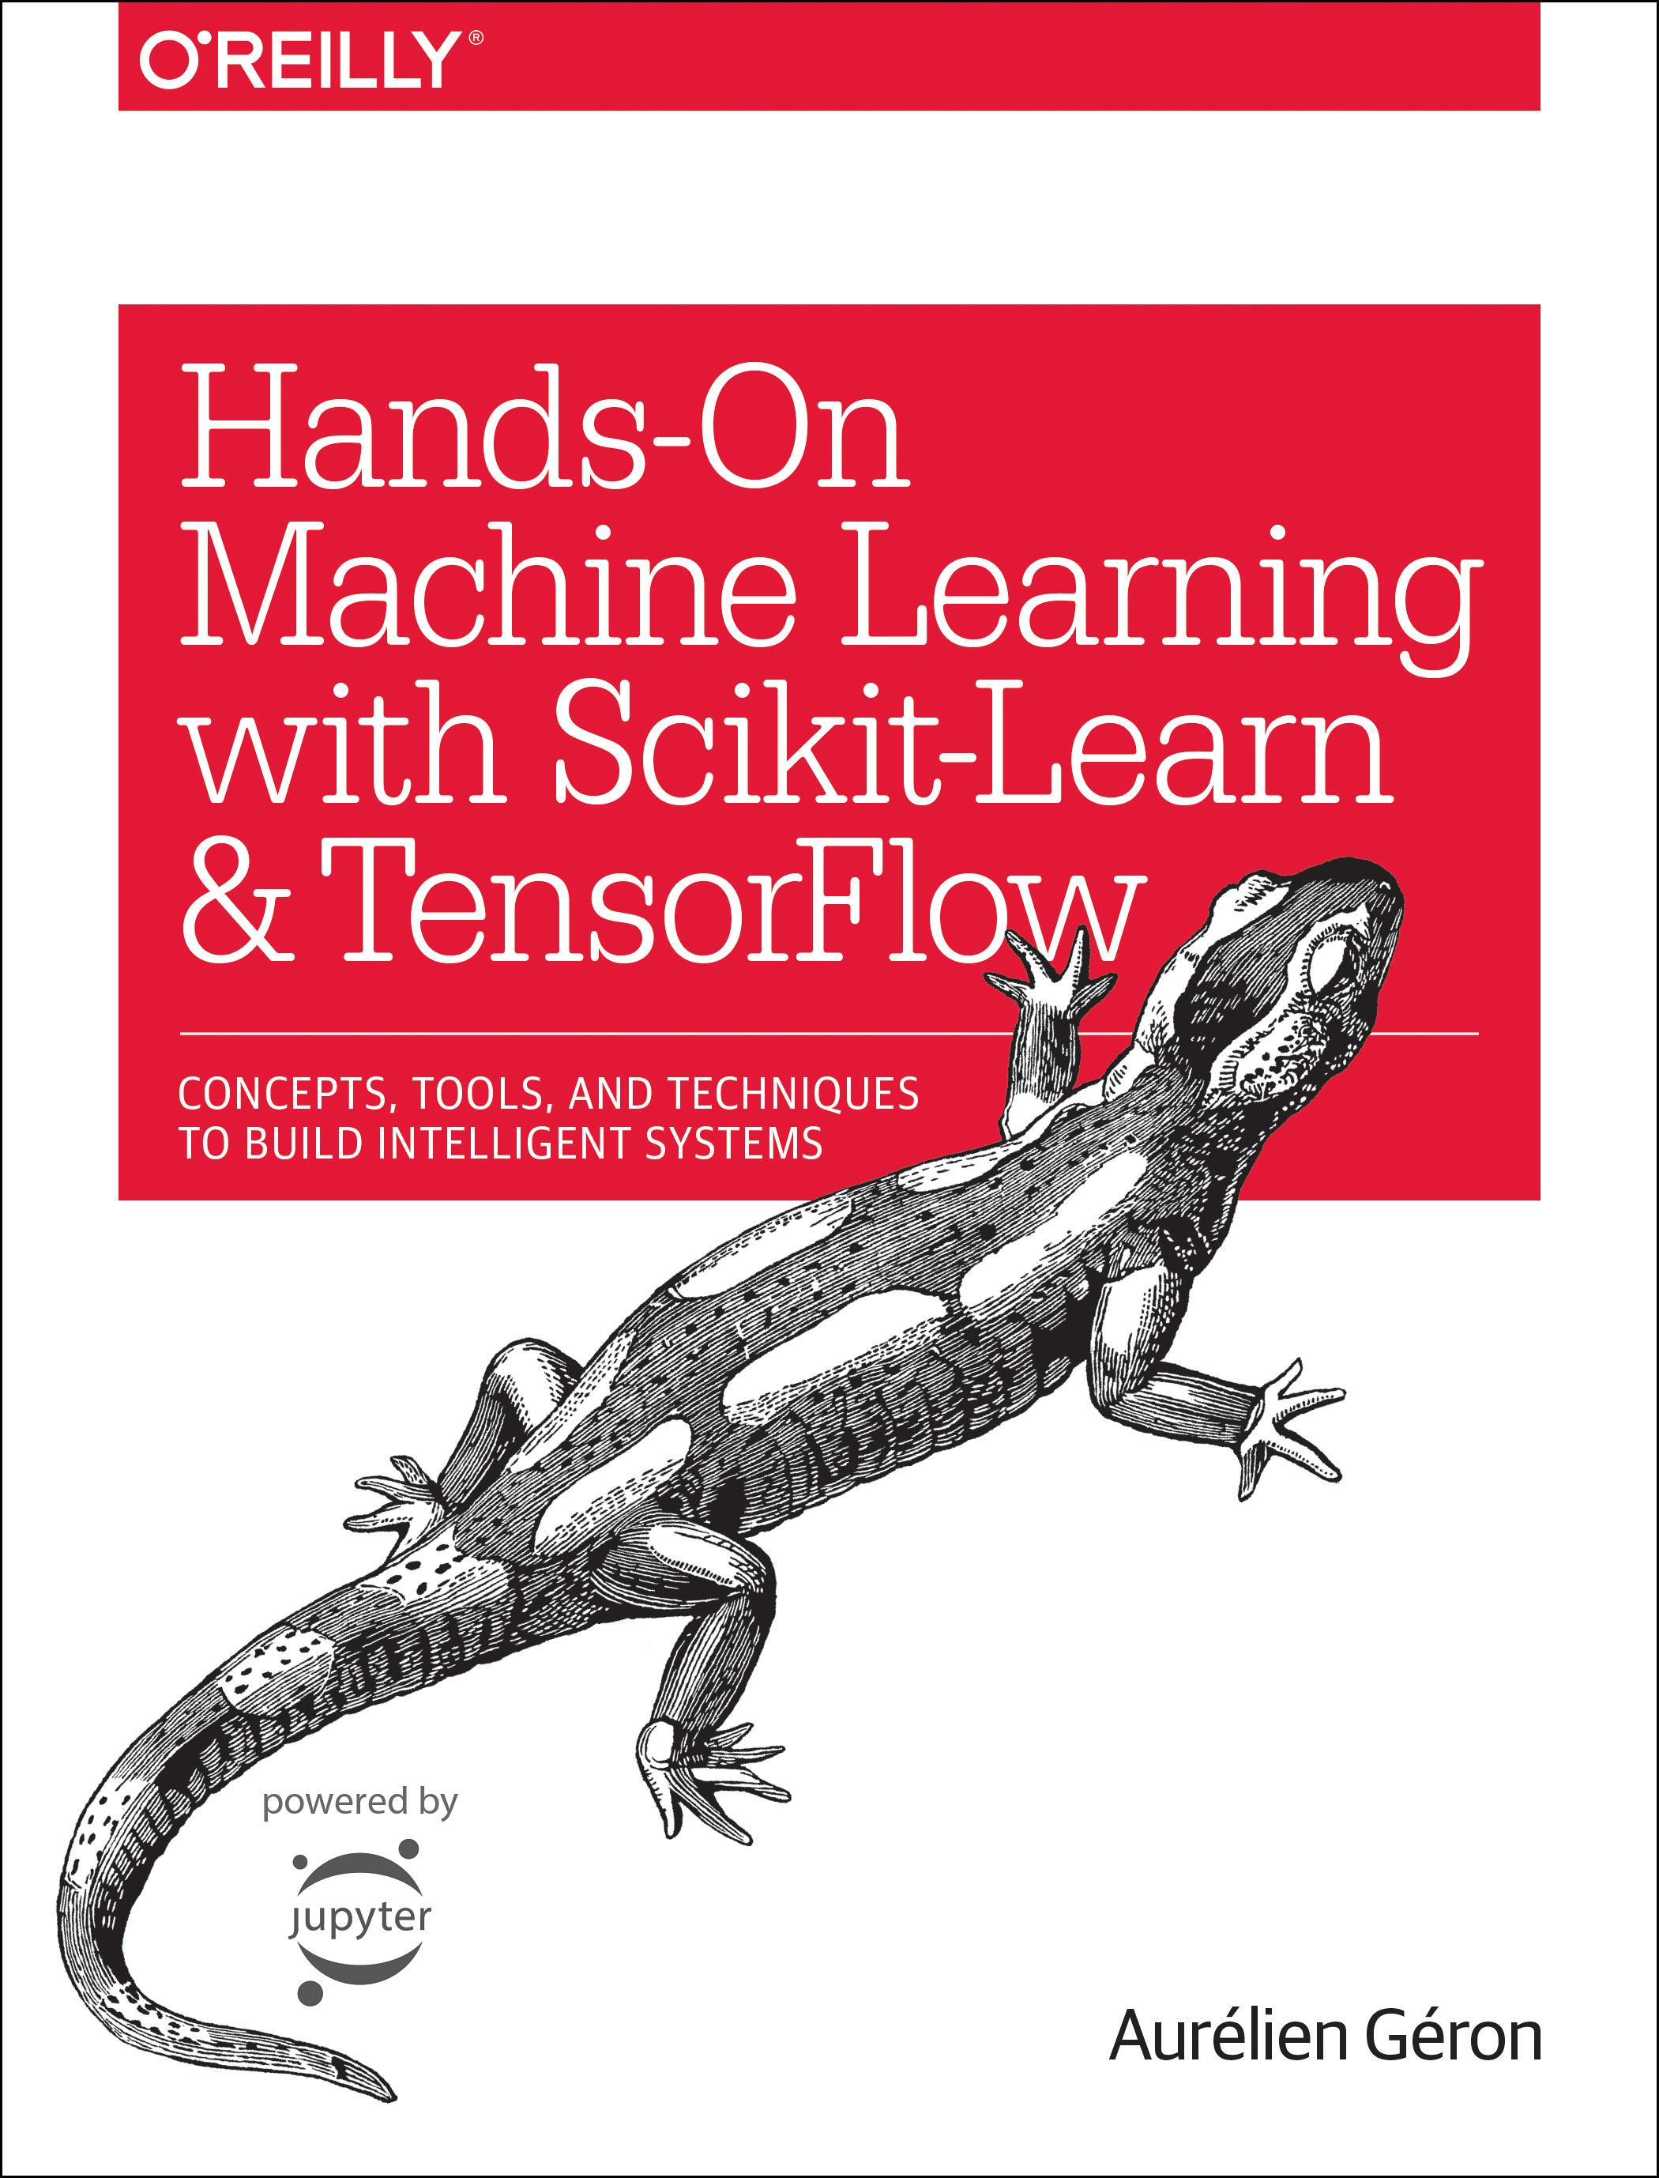
Reference
Chapter 13 (O'Reilly) of Hands-On ML
Youtube on urllib.request.urlretrieve
Youtube on Dataset flower
Youtube
Code

Slide 3
os.path.join is string concatenation with backslash inserted os.path.exists asks whether there is such directory or file os.path.dir asks whether path is dir os.makedirs makes dirs, whereas os.mkdir makes dir os.listdir makes list of all files in dir

Slide 4
Download flower

Slide 5
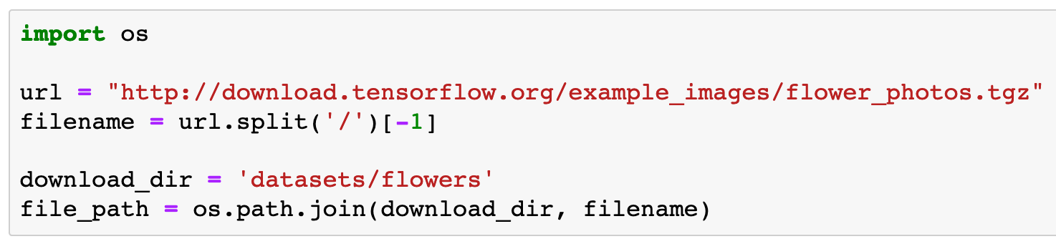

Slide 6
os.path.join is string concatenation with backslash inserted

Slide 7
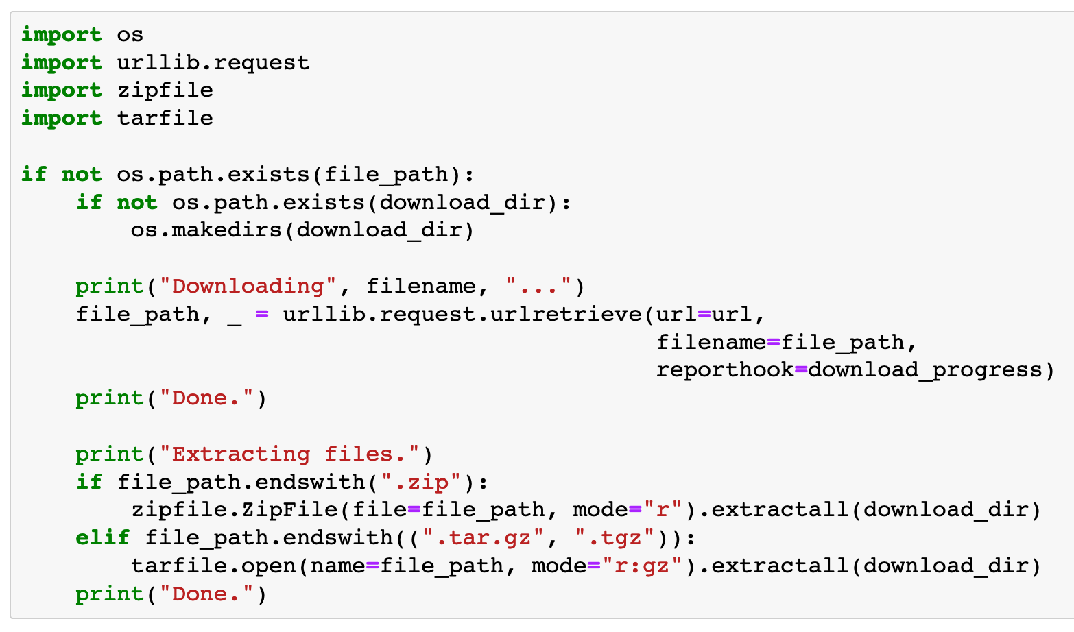

Slide 8
os.path.exists asks whether there is such directory or file

Slide 9
os.makedirs makes dirs, whereas os.mkdir makes dir

Slide 10
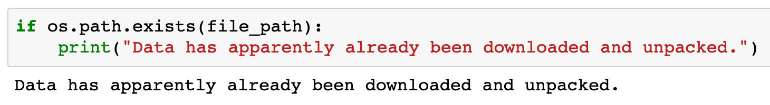

Slide 11
os.path.exists asks whether there is such directory or file

Slide 12
Create flower_classes list

Slide 13
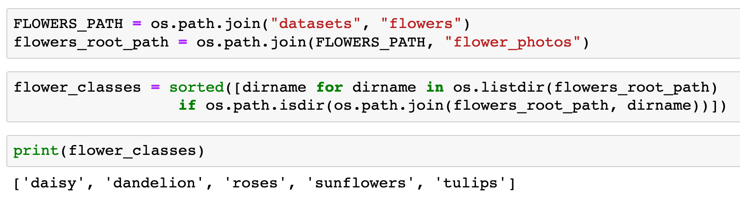


Slide 14
os.path.join is string concatenation with backslash inserted

Slide 16
os.listdir makes list of all files in dir

Slide 17
os.path.dir asks whether path is dir

Slide 19
Create image_paths dict

Slide 20
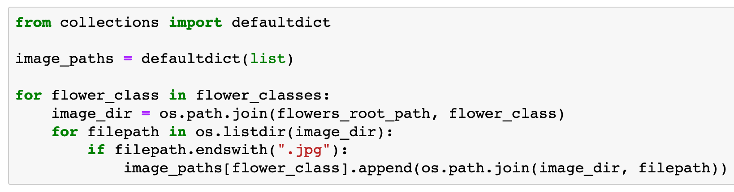

Slide 21
os.path.join is string concatenation with backslash inserted

Slide 22
os.listdir makes list of all files in dir

Slide 23
Now
Let’s Play with Code

